Slide 1

Forensic Audit Logging for PostgreSQL
Moshe Jacobson
http://cyanaudit.neadwerx.com

Slide 2

The Situation
Data is mysteriously wrong/missing
Legal is asking for records
Who, when, how?
How to respond?
CYA with proof!
Notes:
Data wrong due to: race conditions; uncaught error conditions; unpredictable customers; heisenbugs
Customer/boss looking for scapegoat
Data went missing and you have no proof it was there?
Restore a backup to find it? Forgetaboutit
Is it a bug?
Stories?

Slide 3
Application-Level Logging
Explicit
Tedious
Easy to miss something
Not always consistent
Increases development time
Better alternative?
Notes:
Do you add logging as you go? Or afterward?
Tell about event tables, meta fields.
Different places logging same event differently!

Slide 4
Database-Level Logging
pg_audit https://github.com/jcasanov/pg_audit
pgtrail http://code.google.com/p/pgtrail/
tablelog http://pgfoundry.org/projects/tablelog/
Audit trigger 91plus http://wiki.postgresql.org/wiki/Audit_trigger_91plus
Half-baked home-grown solutions?
I wanted something better.
Notes:
Note last updated timestamps here.

Slide 5
Our Application
80,000 users
1TB database
450 tables, 3200 columns
14 million daily page requests
8.5 million daily database updates
99.999% uptime SLA

Slide 6
Wishlist
Extension-based
Space-efficient, organized logging
Per-column control of logging
Attach descriptions to events
Scalability to years’ worth of logs
Export / import between log & files
Automated log maintenance
Easy recovery from mistakes

Slide 7
Cyan Audit - Logged Data
Timestamp
Name of table & column modified
Integer PK of row modified
  You do have integer surrogate PKs, right??
Application-level userid of responsible user
Transaction ID
Application-supplied description
Operation type ('I', 'U', 'D')
Old and new values (stored as text)

Slide 8
Installation – Part I
Unpack extension tarball, “make install”
Configure custom_variable_classes
in postgresql.conf (9.1 only):
custom_variable_classes = 'cyanaudit'
Create extension
db=# create schema cyanaudit;
db=# create extension cyanaudit schema cyanaudit;
Set up logging triggers
db=# select cyanaudit.fn_update_audit_fields();
Now you’re logging!
Notes:
Mention two letter prefixes such as fn_
At end, summarize mandatory vs. optional steps

Slide 9
Installation – Part II
Install cron jobs to rotate and archive logs
Set your database-specific settings
alter database mydb
set cyanaudit.archive_tablespace = 'big_slow_drive';
... set cyanaudit.user_table = 'users';
... set cyanaudit.user_table_uid_col = 'entity';
... set cyanaudit.user_table_username_col = 'username';
... set cyanaudit.user_table_email_col = 'email_address';
Add cyanaudit schema to database search path
alter database mydb
set search_path = public, cyanaudit;
Notes:
Mention two letter prefixes such as fn_
At end, summarize mandatory vs. optional steps

Slide 10
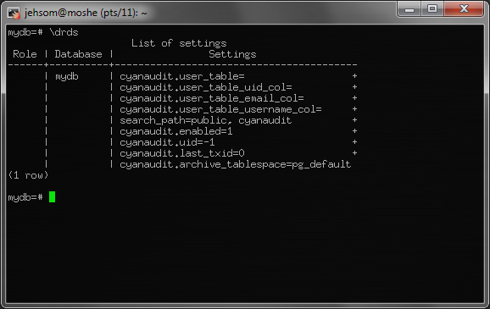
Post-installation

Slide 11
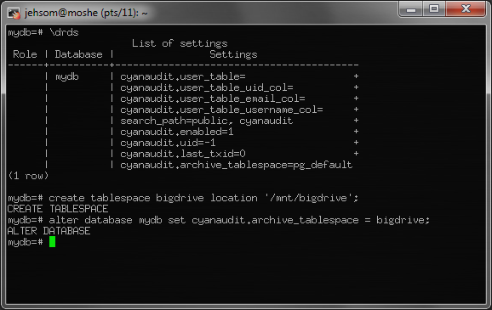
Post-installation

Slide 12

Selecting what to log
Upon installation,
all fields are enabled
Consider high traffic fields
tb_audit_field has
one row per table/column
"active" boolean controls logging for a column
select fn_update_audit_fields()
reindexes fields after DDL
Disable logging for a session:
set cyanaudit.enabled = 0

Slide 13
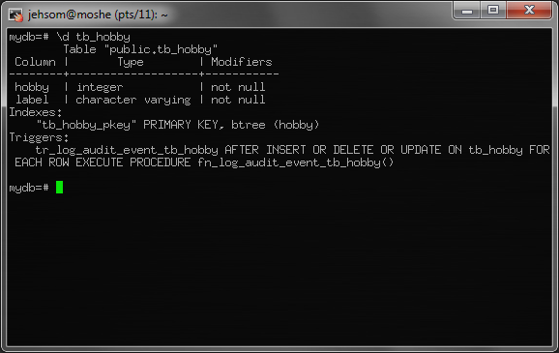
Selecting what to log
Notes:
Mention naming scheme of triggers and that they are created automatically

Slide 14
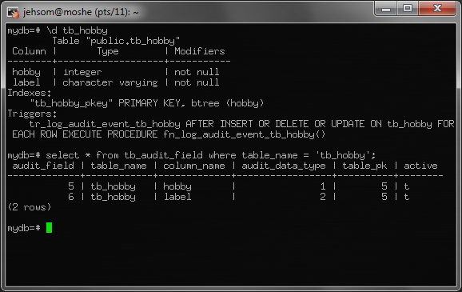
Selecting what to log

Slide 15
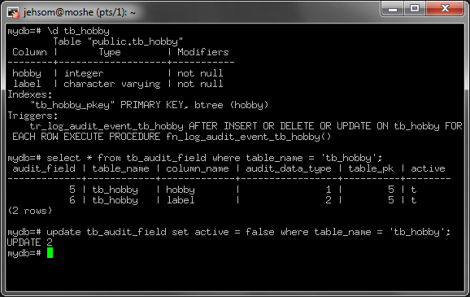
Selecting what to log

Slide 16
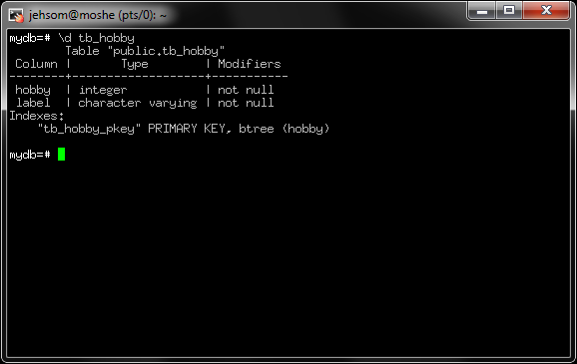
Selecting what to log

Slide 17
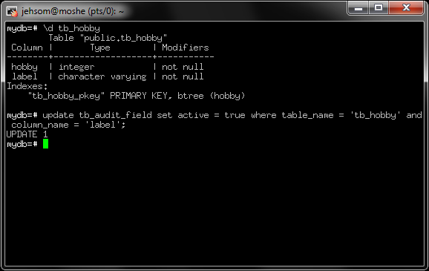
Selecting what to log

Slide 18
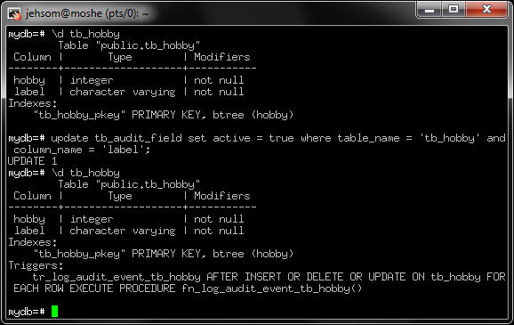
Selecting what to log

Slide 19
Querying the audit log
View: vw_audit_log
Columns:
recorded | uid | user_email | txid | description | table_name | column_name | pk_val | op | old_value | new_value
Millions of rows accumulate quickly
  Especially when you’re doing admin work and forget to turn off logging…
Use indexed columns when querying:
recorded, table_name + column_name, txid

Slide 20
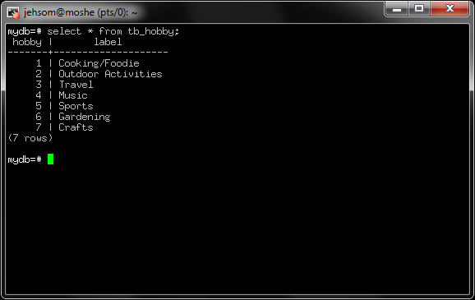
Example

Slide 21
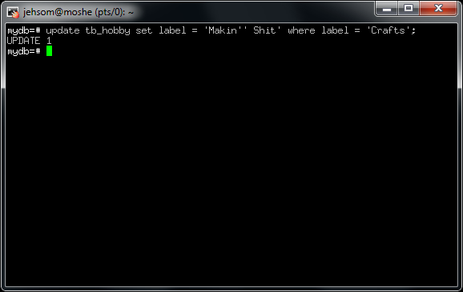
Example

Slide 22
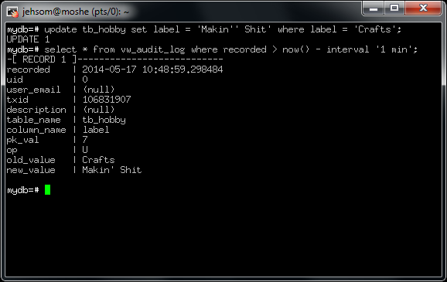
Example
Notes:
Extended format not typical!

Slide 23
Reconstructing Queries
View:
vw_audit_transaction_statement
Reconstructs queries effectively equivalent to original DML
Columns:
txid | recorded | email | description | query

Slide 24
Reconstructing Queries

Slide 25
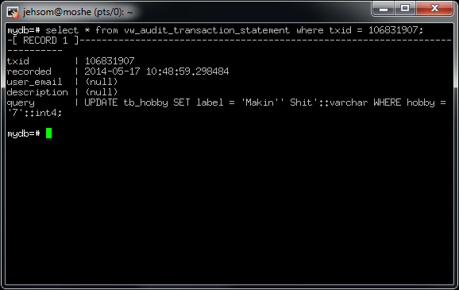
Reconstructing Queries

Slide 26
When You F*** Up…
We can reconstruct queries…
Why not reverse them?
fn_undo_transaction(txid)
Undoes recorded changes for txid
fn_get_last_audit_txid()
Gives txid of last logged transaction
select fn_undo_last_transaction()
Combines two functions above.
Notes:
Story of working 3 days straight to fix data error.
Can only undo recorded DML
Undo not accurate if on out of order

Slide 27
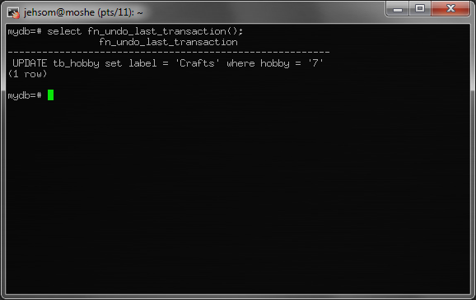
When You F*** Up

Slide 28
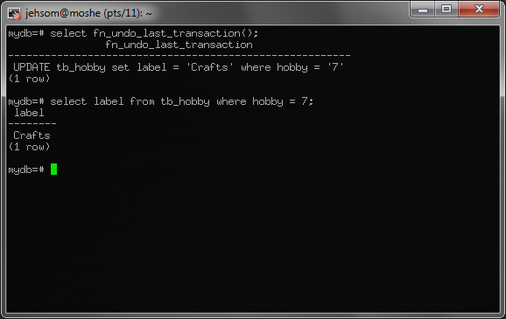
When You F*** Up

Slide 29
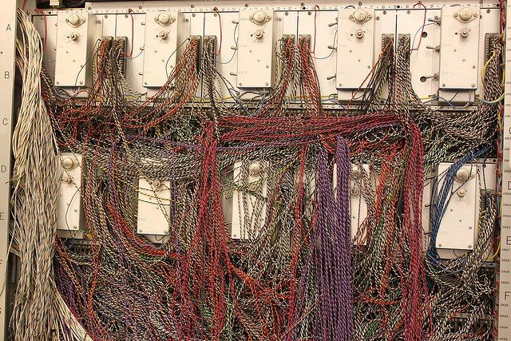
Application Integration
How DBAs see application code:
Notes:
Scary middleware code!

Slide 30
Application Integration
Don't want to? Don't have to!
Two modifications if you want:
  Attach UIDs to transactions
  Attach descriptions to transactions
Notes:
Scary middleware code!

Slide 31
Attaching UIDs to DML
fn_set_audit_uid(uid)
Match current_user to user_table_username_col
Otherwise, assume 0

Slide 32
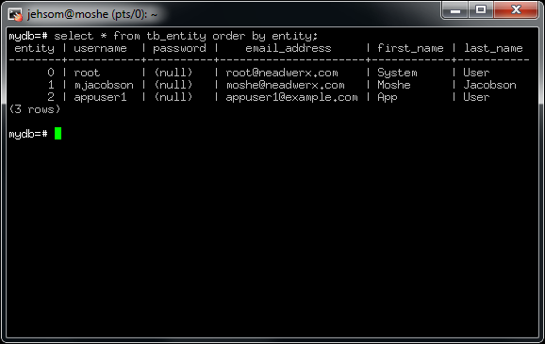

Attaching UIDs to DML

Slide 33
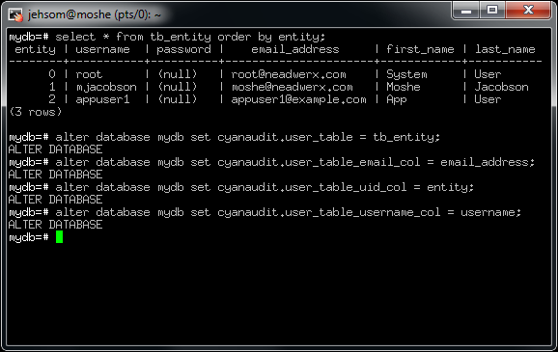
Attaching UIDs to DML

Slide 34
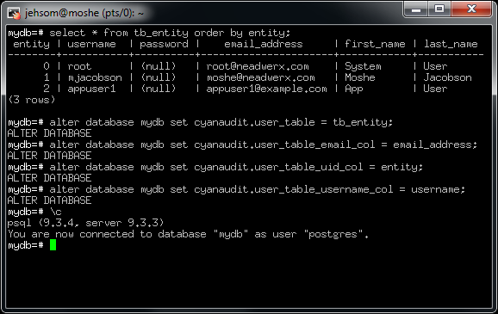
Attaching UIDs to DML

Slide 35
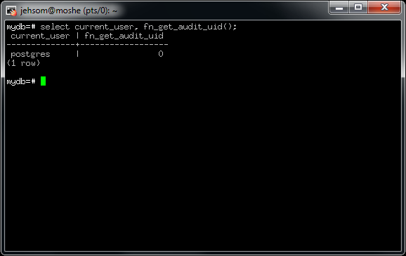
Attaching UIDs to DML

Slide 36
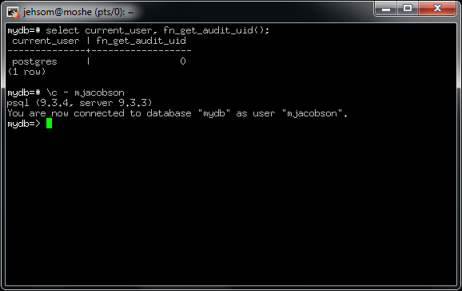
Attaching UIDs to DML

Slide 37
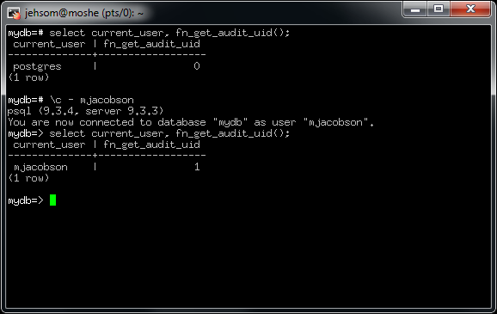
Attaching UIDs to DML

Slide 38
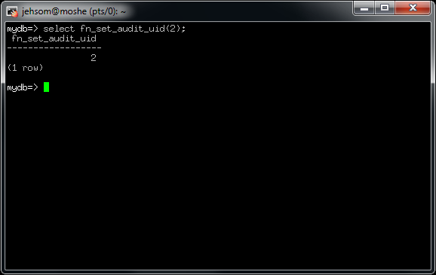
Attaching UIDs to DML

Slide 39
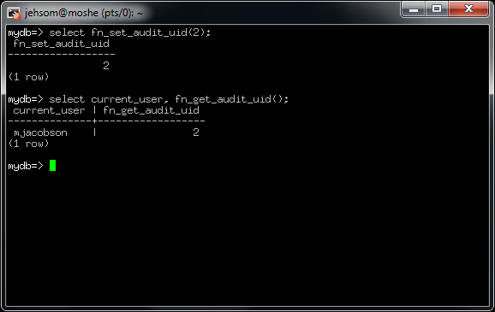
Attaching UIDs to DML

Slide 40
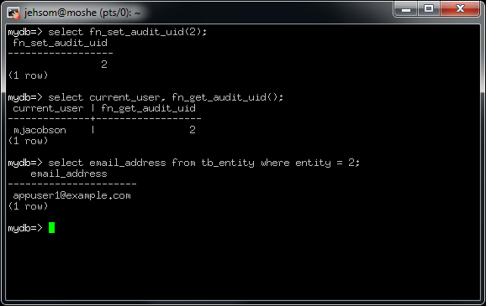
Attaching UIDs to DML

Slide 41
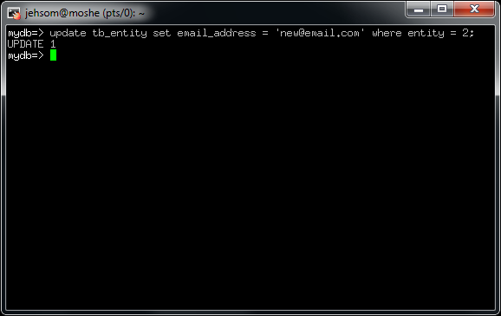
Attaching UIDs to DML

Slide 42
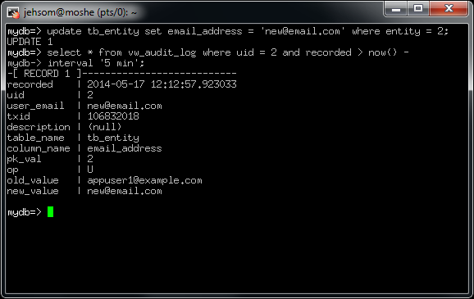
Attaching UIDs to DML

Slide 43
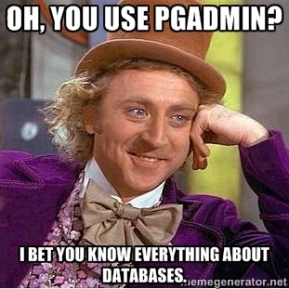
Labeling transactions
Not everyone understands
the schema.
Let's help them out.
Two functions for labeling transactions:
fn_label_audit_transaction(label, txid)
fn_label_last_audit_transaction(label)

Slide 44

Labeling transactions

Slide 45
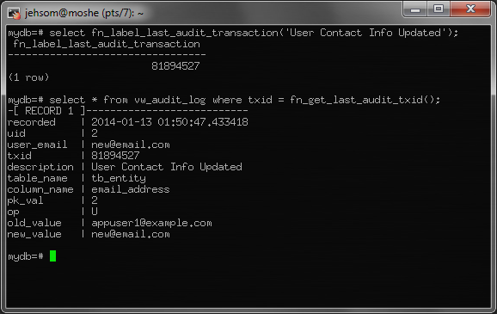
Labeling transactions

Slide 46

Log Rotation/Archival
You’re gonna run out of space eventually.
What is the solution?

Slide 47
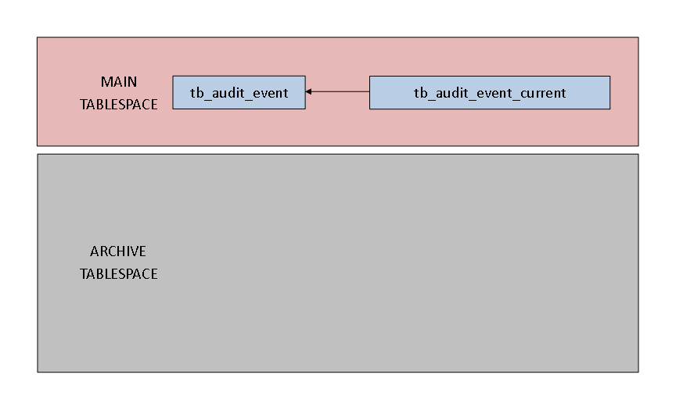
Log Rotation/Archival

Slide 48
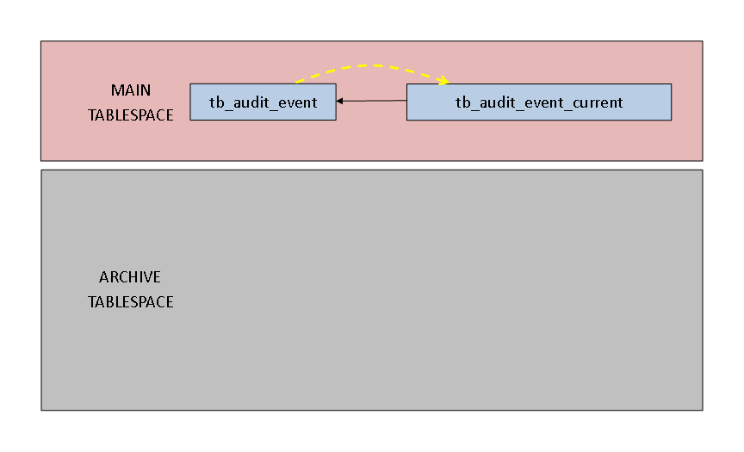
Log Rotation/Archival

Slide 49
Log Rotation/Archival

Slide 50
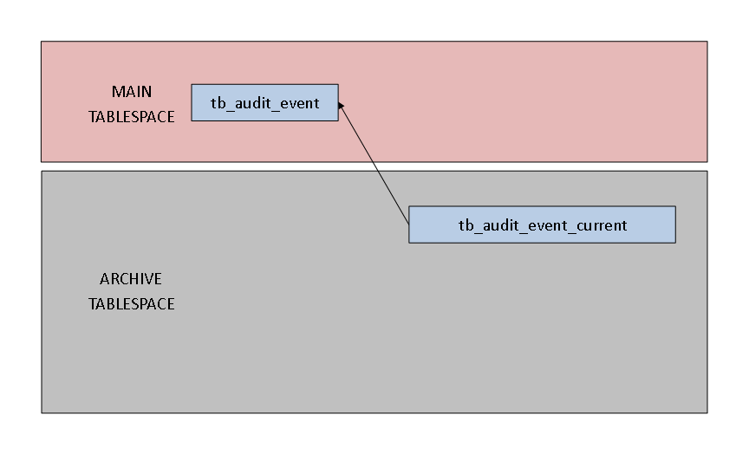
Log Rotation/Archival

Slide 51

Log Rotation/Archival

Slide 52
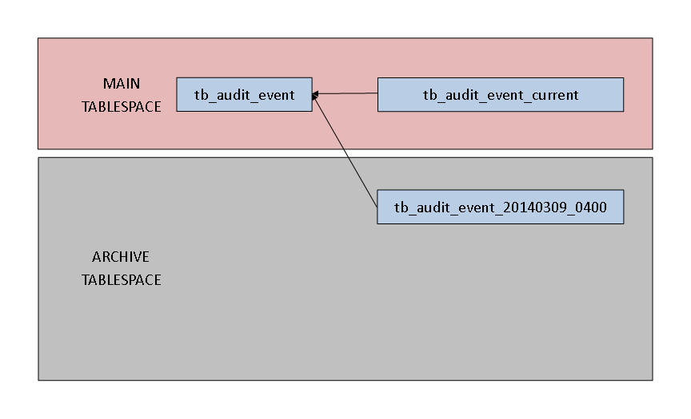
Log Rotation/Archival

Slide 53
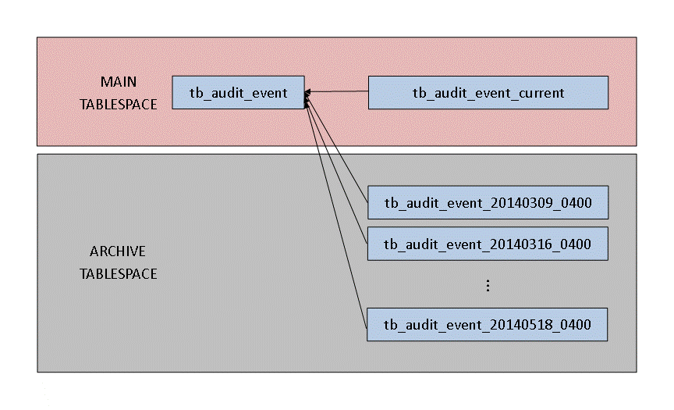
Log Rotation/Archival

Slide 54
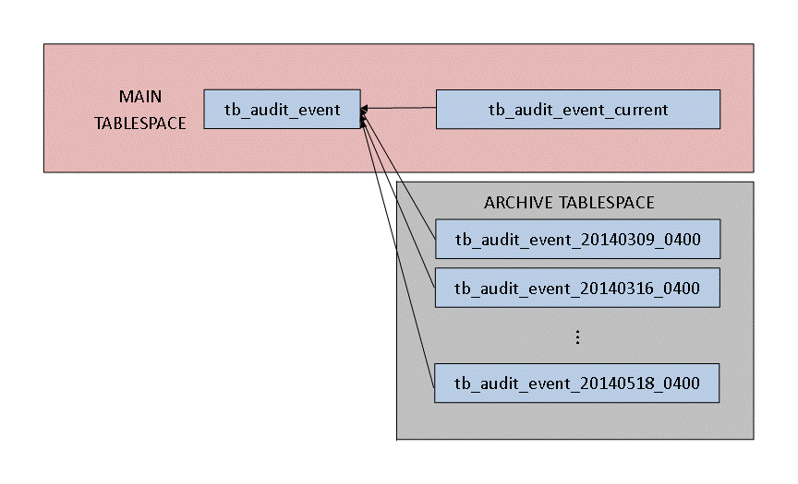
Log Rotation/Archival

Slide 55
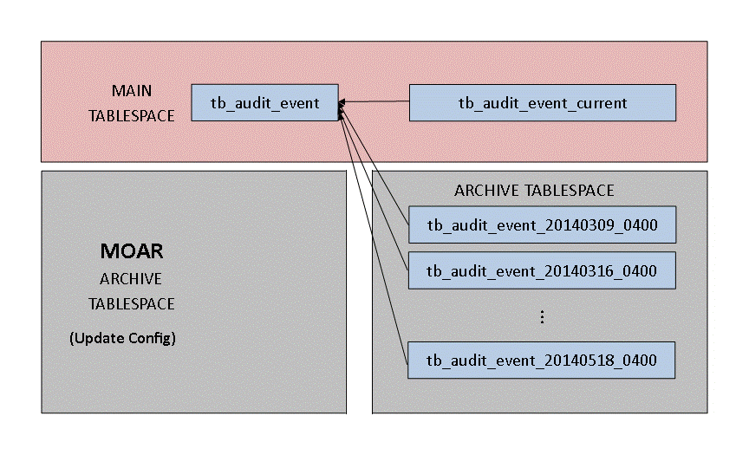
Log Rotation/Archival

Slide 56
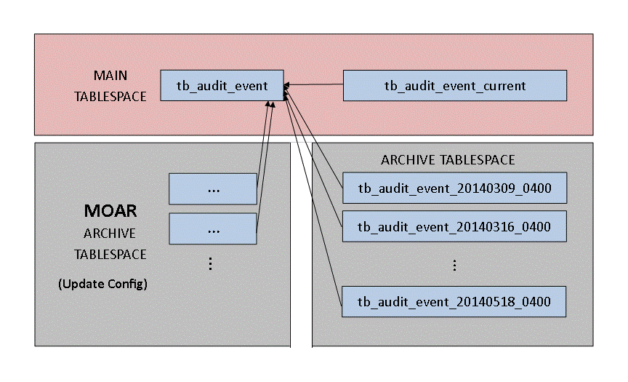
Log Rotation/Archival

Slide 57
Log Rotation/Archival
cyanaudit_log_rotate.pl
Log entries since last rotation become a new child partition of parent table tb_audit_event.
cyanaudit_dump.pl
Back up audit data, remove old tables.
cyanaudit_restore.pl
Restore dumps created with cyanaudit_dump.pl

Slide 58
Wishlist – Nailed it!
Extension-based
Space-efficient, organized logging
Per-column control of logging
Attach descriptions to events
Scalability to years’ worth of logs
Export / import between log & files
Automated log maintenance
Easy recovery from mistakes
Plus: Released under PostgreSQL license

Slide 59
Cyan Audit Caveats
PostgreSQL version compatibility:
  >= 9.3.3: All features supported
  < 9.3.3: No DDL triggers. After any DDL you must
  select fn_update_audit_fields()
  < 9.2.0: Must modify postgresql.conf with custom_variable_classes = cyanaudit
  < 9.1.7: Not supported
Logs only tables with integer PK.
Logs only public schema.
Truncates are not logged.
Does not store original SQL.
Notes:
Mention bug in 9.1.6 – Extension’s sequences not correctly saved in dump/restore
Mention bug in 9.3.2 - Extension’s event triggers not correctly saved in dump/restore

Slide 60
Cyan Audit Challenges
Proper behavior with pg_dump/pg_restore
Log tables using OID as PK
Log tables in other schemas than public
Amazon RDB – non-extension version?
Automatic testing
Leverage 9.4’s logical replication
Wide use, inclusion with PostgreSQL core! YEAAH!
Notes:
Mention bug in 9.1.6 – Extension’s sequences not correctly saved in dump/restore
Mention bug in 9.3.2 - Extension’s event triggers not correctly saved in dump/restore

Slide 61

Questions? Comments?
Moshe Jacobson moshe@neadwerx.com
Download: http://cyanaudit.neadwerx.com
Thanks to Nead Werx, my employer, for sponsoring the development of Cyan Audit.

